Slide 1

SQL Server
Execution Plan Primer
DevSpace Conference
11 October 2019
Allison Benneth
@sqltran www.sqltran.org

Slide 2


DevSpace would like to thank our sponsors

Slide 3
Agenda
Why do we care about execution plans?
What are the inputs to the optimizer?
How does the optimizer generate a plan?
What types of plans are there?
What operators do we see in execution plans?
What are some useful ways to execute a plan?

Slide 4
Why Care about Execution Plans?
SQL is a declarative language
  We are telling the server WHAT we want, not how to answer the question
The execution plan tells us HOW SQL Server is resolving the query
Can be very useful to identify performance issues

Slide 5
Why Care about Execution Plans?
Execution plans provide front-line insight into decisions made by the optimizer
  Order in which tables are accessed
  What indexes are used
  How much data is expected
  “Hidden” internal operations

Slide 6
Why Optimize?
select per.FirstName,
per.LastName,
soh.ShipDate,
soh.TerritoryID
from Person.Person per
join Sales.Customer cust on per.BusinessEntityID = cust.CustomerID
join Sales.SalesOrderHeader soh on cust.CustomerID = soh.CustomerID
join Sales.SalesOrderDetail sod on sod.SalesOrderID = soh.SalesOrderID
join Production.Product prod on sod.ProductID = prod.ProductID
where prod.Name = 'Mountain Bottle Cage'
and soh.ShipDate >= '2014-04-01'
and soh.TerritoryID in (7, 8);
Notes:
In theory, we could just have SQL scan each of these tables, match the join clauses, filter by the where clauses, and do whatever other processing is necessary to resolve the query.
But there is likely a better way.
What indexes exists on the tables? What is the best order to perform the joins? And there are likely many other ways that the query can manipulated to increase efficiency.

Slide 7
Inputs to Optimization
The query text
Physical specs of system (memory, cores, etc.)
SET options in effect
Cardinality estimates
DB properties of referenced objects (data types, nullability, check constraints, foreign keys, uniqueness, etc.)
Plan cache (optimizer bypass)
Notes:
The optimizer is the part of SQL Server that takes a SQL query and produces an execution plan.
First the query text is parsed, checked for syntactical correctness, and converted into an internal tree structure.
Several SET options can affect the query plan: ANSI_NULLS, ANSI_PADDING, ANSI_WARNINGS, ARITHABORT, CONCAT_NULL_YIELDS, NUMERIC_ROUND_ABORT, QUOTED_IDENTIFIER, XACT_ABORT

Slide 8
Items that are NOT optimizer inputs
Has the data already been loaded into memory?
  Cold cache is assumed
Type of I/O subsystem
  Spinning disk vs. SSD

Slide 9
Cardinality Estimation
How many rows will this part of the query generate?
SQL Server will always generate an estimate
May be based on statistics or just a guess (heuristics)
Two primary versions of estimator
  SQL Server 7
  Server Server 2014
    (But each later version of SQL has its own CE)
Version used based on compatibility level, DB settings, trace flags, query hints

Slide 10
Statistics
SomeTable has 1,000,000 rows
There is an index on SomeColumn
How many rows will the query generate?
select ID, SomeColumn, Description
from dbo.SomeTable
where SomeColumn = 123456;

Slide 11
Selectivity
It depends on how selective SomeColumn is
Maybe every row has 123456
  Low selectivity
Or maybe every row is unique
  High selectivity
Or somewhere in-between

Slide 12
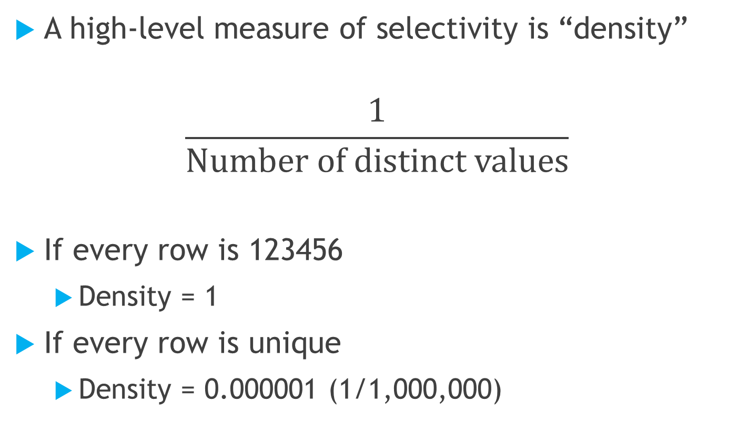
Selectivity
A high-level measure of selectivity is “density”
$$\frac{\text{1}}{\text{Number} \text{of} \text{distinct} \text{values}}$$
If every row is 123456
  Density = 1
If every row is unique
  Density = 0.000001 (1/1,000,000)

Slide 13
Let’s get more specific
select c.ID, c.FirstName, c.LastName, c.State
from dbo.Customer c
where c.LastName like ‘B%';
select c.ID, c.FirstName, c.LastName, c.State
from dbo.Customer c
where c.LastName like ‘Q%';

Slide 15
An equality query
select c.ID, c.FirstName, c.LastName, c.State
from dbo.Customer c
where c.LastName = 'Baker';

Slide 16


Baker = 1193 rows

Slide 17
How about this one?
select c.ID, c.FirstName, c.LastName, c.State
from dbo.Customer c
where c.LastName = 'Baldwin';
Between Baker & Barnes: average key has 3.603 rows
Estimate is 3.603 rows (actual is 210 rows)
But 'Banjo' will also be estimated as 3.603 rows (actual = 1)

Slide 18
Statistics: Key Points
Based on contents of the index at some past time
Maximum of 200 steps
Becomes a key input to the cardinality estimator
Update frequency based on how many rows in the table have been modified
  Through SQL 2014: 20% of rows
  After SQL 2016: Default is more aggressive updating
  DBA jobs to update (Ola Hallengren maintenance solution)

Slide 19
Types of Execution Plans
Text
XML
Graphical
select c.State, sum(od.Quantity * od.UnitPrice) as OrderAmount
from dbo.OrderHeader oh
join dbo.OrderDetail od on od.OrderId = oh.OrderId
join dbo.Customer c on c.CustomerID = oh.CustomerId
where od.ProductId >= 760 and od.ProductId <= 792
group by c.State;

Slide 20
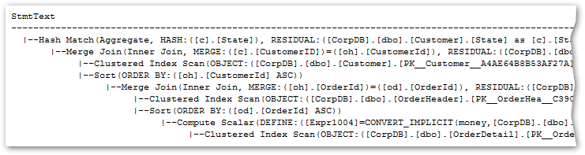
Types of Execution Plans – Text (Deprecated)
set showplan_text on; (less detail)
set showplan_all on; (more detail)

Slide 21
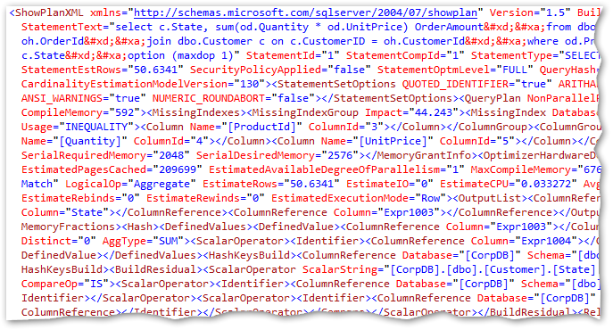
Types of Execution Plans - XML
set showplan_xml on;

Slide 22
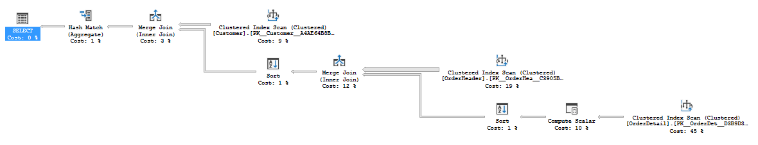
Types of Execution Plans - Graphical
Display Estimated Execution Plan (Ctrl-L)

Slide 23
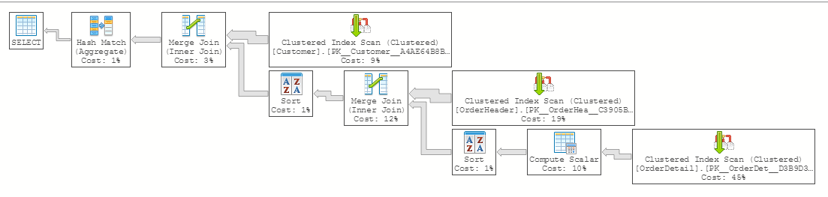
Types of Execution Plans - Graphical
Azure Data Studio

Slide 24
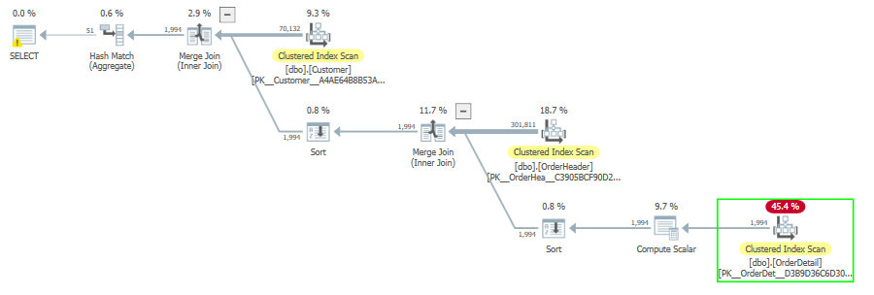
Types of Execution Plans - Graphical
Alternate way to view graphical plans (SentryOne Plan Explorer)

Slide 25
Types of Execution Plans – Estimated vs Actual
Estimated execution plans
  Query is not executed
  Best guess of plan that would actually be used
  In some cases cannot be generated
Actual execution plans
  Query is executed
  Some chance it may differ from estimated plan
  Includes runtime statistics (actual rows)

Slide 26
Actual Execution Plans
Actual plan - text
  set statistics profile on;
Actual plan – XML
  set statistics xml on;
Actual plan – Graphical
  Include Actual Execution Plan (Ctrl-M)

Slide 27
Two Types of Tables
Heaps
  Not organized in any particular way
  No index structure on top of data
  Can still have nonclustered indexes
Clustered Index
  Data is stored in key order
  Has a B-tree structure on top of the data
  Can also have nonclustered indexes

Slide 28
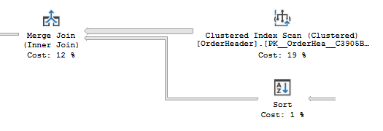
The Execution Plan
Consist of operators and connectors
Connector (flow of data)
  Width indicates number of rows
Plans are frequently read right-to-left, top-to-bottom

Slide 29
Operators
About 70 operators possible; most are infrequently seen
Responsible to respond for a request for the next row
Common operators
  Data Access (scans, seeks, lookups)
  Joins (merge, nested loops, hash)
  Other (sorts, aggregations, spools, etc.)
Full list of operators

Slide 30
Operators – Data Access
Scan – Read entire contents of object
Does not necessarily return all rows read
May result from non-SARGable predicates
Myth: scans are evil
Clustered Index Scan
Index Scan
Table Scan

Slide 31
Operators – Data Access
Seek – Uses index structure to find key values
  Can be a point lookup or involve a partial scan
Cannot seek into a heap
Myth: seeks are always good
Clustered Index Seek
Index Seek

Slide 32
Scans vs. Seeks
SQL will tend to favor scans if the number of rows expected is large enough that cost for a (sequential) scan is less than the cost of random I/O for seeks
  “Tipping point”
Cardinality errors can cause the “wrong” access type to be used

Slide 33
Operators – Data Access
Lookup – Retrieve additional columns from table
  Used when non-clustered index does not have all the columns needed to resolve query (not covering)
Useful when number of lookups is small
Key Lookup
RID Lookup

Slide 34
Operators – Joins
Three main join algorithms
  Merge Join
  Nested Loop Join
  Hash Join
(Also adaptive join, hybrid nested loop and hash)

Slide 35
Operators – Merge Join
Requires both tables to be sorted on join columns
  May introduce intermediate sort operation
  But sorts are expensive
Useful when data is already naturally sorted by join columns
Bert Wagner video with
animation of merge join

Slide 36

Operators – Nested Loop Join
Compare each row in top input with each row in bottom input
Bottom input may be static or may change depending on value of top row
Useful when top input is small and bottom input is efficient to search
Bert Wagner video with
animation of loop join
Notes:
Nested loops is the universal join operator; it will work for pretty much any join situation (or the query can be readily re-written to make it work).
Cross joins, inner joins
Outer joins (technically not right or full, but can re-written)
Semi joins, anti-semi joins
Join predicates that both equality and inequality

Slide 37

Operators – Hash Join
Each top row is hashed by join columns and bucketized
Each bottom is hashed, looked up in hash table
Useful when both inputs are large and unsorted
Bert Wagner video with
animation of loop join

Slide 38

Operators – Set Operations
Concatenation (UNION ALL)
Other operations (UNION, INTERSECT, EXCEPT) handled by combinations of operators
Concatenation

Slide 39
Operators – Sort
Tends to be a very expensive operation
Highly dependent on cardinality estimate
  Drive memory grant
Watch for spills to tempdb
Is the sort really needed?
Sort

Slide 40
Operators – Aggregation
Calculate SUM, COUNT, AVG, MIN, MAX, etc.
Hash aggregate builds hash table to find common rows (based on grouping columns)
Stream aggregate input must be sorted, watches for changes in grouping columns
Hash Aggregate
Stream Aggregate

Slide 41
Operators – SELECT
(Or INSERT, DELETE, UPDATE, MERGE)
Left-most pseudo-operator
Contains properties of the execution plan as a whole
SELECT

Slide 42
Operators
And many, many more operators
  Various Insert, Update, Delete, Merge operators
    Clustered idx, non-clustered idx, heap
  Compute Scalar, Constant Scan
  Spools (Eager vs. Lazy)
  Parallelism
    Distribute Streams, Repartition Streams, Gather Streams
  Etc.

Slide 43

Demo
Execution problem pain points
Notes:
Scripts 020 through ???

Slide 44
Resources
Grant Fritchey, SQL Server Execution Plans, 3rd Edition (free download)
AdventureWorks2014 (download)

Slide 45
Thank You
This presentation and supporting materials can be found at www.sqltran.org/executionplans
  Slide deck
  Scripts
allison@sqltran.org • @sqltran

